Slide 1
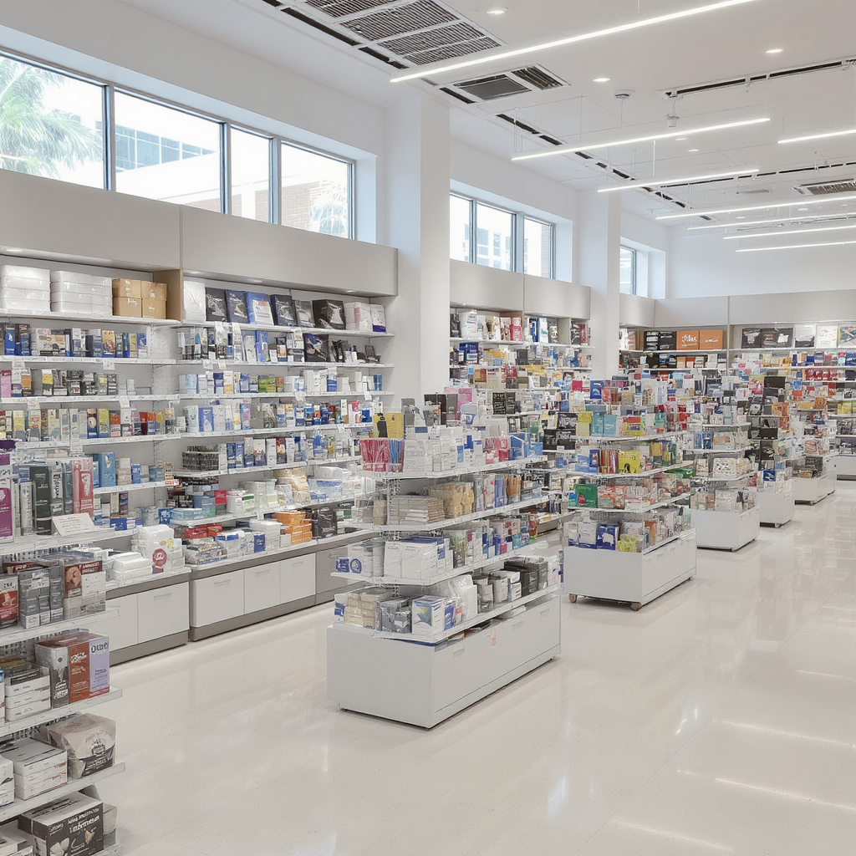

Office Supply Store Trends 2020
Foot Traffic and Dwell Time Trends at Office Supply Stores During the Remote Work Shift
October 12, 2025

Slide 2
Agenda
Overview and Research Questions Foot Traffic and Dwell Time Insights Demographic Influences Brand Performance and Recovery Geographic Patterns and Recovery Conclusion and AI Support

Slide 3

Overview and Research Questions
Introduction
Customize this slide by adding local demographic data or specific brand examples relevant to your audience's region for greater relatability.
Study Context and Industry Focus
The shift to remote work in early 2020 reshaped consumer behavior, causing a surge in office supply demand. This study focuses on Office Supply Stores in the U.S., analyzing trends in California counties using SafeGraph data and RUCA codes.
Geographic and Demographic Scope
Analysis covers California counties classified as urban, suburban, or rural. Demographics include education levels, working-age (18-64), and K-12 households (5-17), to explore consumer patterns and innovative store concepts.
Research Questions Explored
Key questions address weekly changes in foot traffic and dwell times during early 2020, demographic correlations with visits, and brand recovery patterns indicating loyalty and essential purchasing behavior.

Slide 4
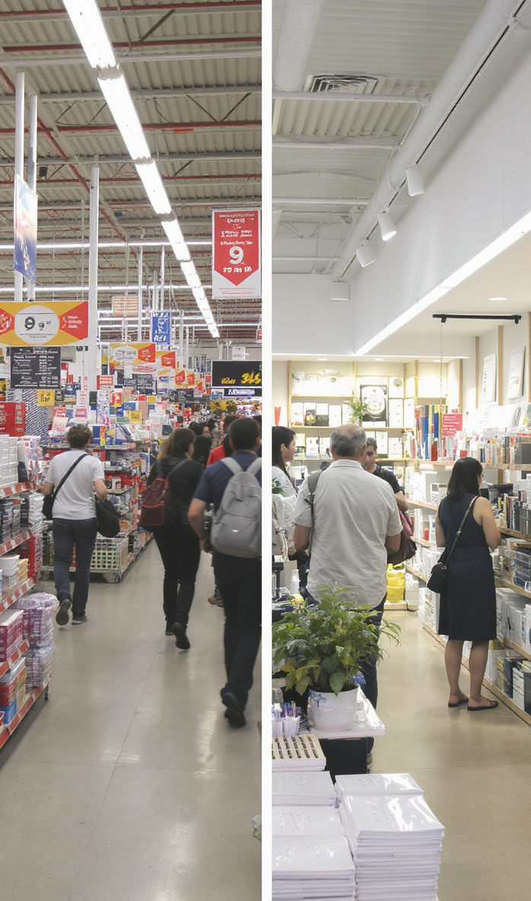
Foot Traffic and Dwell Time Insights
Insights
Use specific visit and dwell time figures to emphasize brand differences, and consider adding examples of how consumer behavior varies by store type to make insights relatable.
Foot Traffic Trends
All brands peaked in Jan & Feb 2020, then dropped sharply from Week 12 (March 16–22) as lockdowns began. Staples and Office Depot led visits, each surpassing 100K weekly pre-March. Staples rebounded in Week 17 with nearly 98K visits, signaling early recovery.
Dwell Time Patterns
Staples and Office Depot have shorter dwell times, showing quick, frequent trips. Specialty stores like Papyrus, Cartridge World, and Rapid Refill draw fewer visitors but with longer dwell times, indicating focused, high-intent purchases. Rapid Refill leads with about 50 minutes dwell time.
Brand Recovery Differences
Recovery timing and magnitude varied by brand due to store footprint, product mix, and regional restrictions. Staples’ strong supply chain and suburban presence helped faster reopening, while others lagged behind.
Bubble Chart Insights
Bubble chart shows Staples and Office Depot dominate visits but with shorter dwell times. Specialty brands cluster with longer dwell times but fewer visits, illustrating efficiency-driven shopping at high-traffic stores versus experience-driven shopping at specialty stores.

Slide 5
Demographic and Geographic Influences
Demographics
01
Visits vs. K–12 Population
Office retailers cluster near suburban, family-oriented populations, driven by school and home-office needs. Staples serves 2.4M K–12 population with 1.76M visits, showing strong presence in family-dense areas. Office Depot shows similar trends; smaller brands serve smaller K–12 populations.
02
Dwell Time vs. Working-Age Population
Counties with higher working-age density (urban/suburban) show shorter dwell times due to faster shopping. Staples, with 10.65M working-age population, averages 16.8 mins dwell time. Cartridge World and Papyrus show longer dwell times, reflecting specialty product interest.
03
Education vs. Engagement
Longer dwell times occur in regions with more bachelor’s and master’s degree holders, reflecting higher disposable income and personalized shopping. Staples serves mixed-education consumers with shorter visits; Paper Source and Papyrus cater to highly educated markets with longer store exploration.
04
Suburban vs. Urban Dynamics
Suburban counties had the highest visits and engagement, led by Staples and Office Depot, showing faster remote work adaptation. Urban areas had slightly lower visits but similar quick trips. Rural areas had fewer visits but longer dwell times, indicating leisurely shopping.
05
Geographic Hotspots
Los Angeles County, CA was a key hotspot with strong office supply demand early in 2020. Specialty brands like Papyrus and Rapid Refill had lower traffic but higher dwell times, indicating purposeful, high-value purchases in niche markets.

Slide 6
Brand Performance, Recovery, and Conclusions
Conclusion
Highlight specific brand recovery milestones and regional data points to emphasize the practical implications for retail strategy.
Brand Stabilization Patterns
Recovery Timelines
Regional Hotspots
Staples and Office Depot showed early stabilization around Weeks 16–17, with visits rebounding by approximately 20–25%. Staples’ rapid rebound from 47K to 98K weekly visits marks it as an essential retailer with strong brand loyalty.
Office Depot had a steady recovery during Weeks 17–18, maintaining consistent visits. OfficeMax lagged with a slower rebound, while specialty brands like Paper Source and Papyrus saw no clear stabilization and continued declines.
Los Angeles County, CA emerged as a key hotspot for office supply demand, with suburban counties leading in visits and engagement, driven primarily by Staples and Office Depot’s presence.
Consumer Behavior Shifts
Essential vs. Discretionary
AI Support in Project
Suburban consumers prioritized quick, goal-oriented purchases at high-traffic retailers. In contrast, shoppers in highly educated, smaller markets favored specialty stores, reflecting a divide between efficiency-driven and experience-driven shopping.
Essential retailers like Staples and Office Depot recovered quickly due to home-office needs. Non-essential brands with creative or discretionary products experienced sustained declines and slower recovery.
AI tools such as ChatGPT and Perplexity AI assisted with SQL debugging, research summarization, and report polishing. All AI-generated suggestions were reviewed and verified by team members to ensure accuracy and quality.

Slide 7
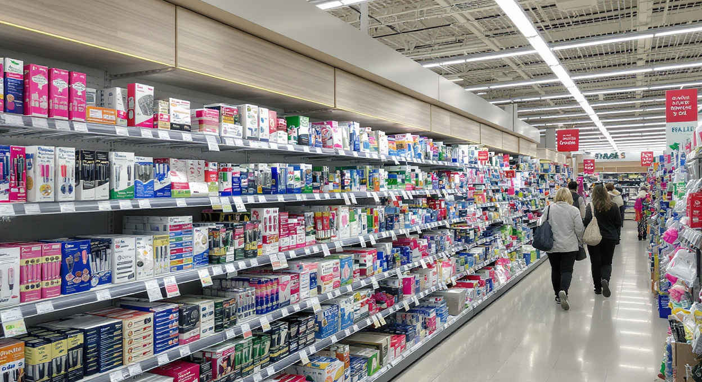
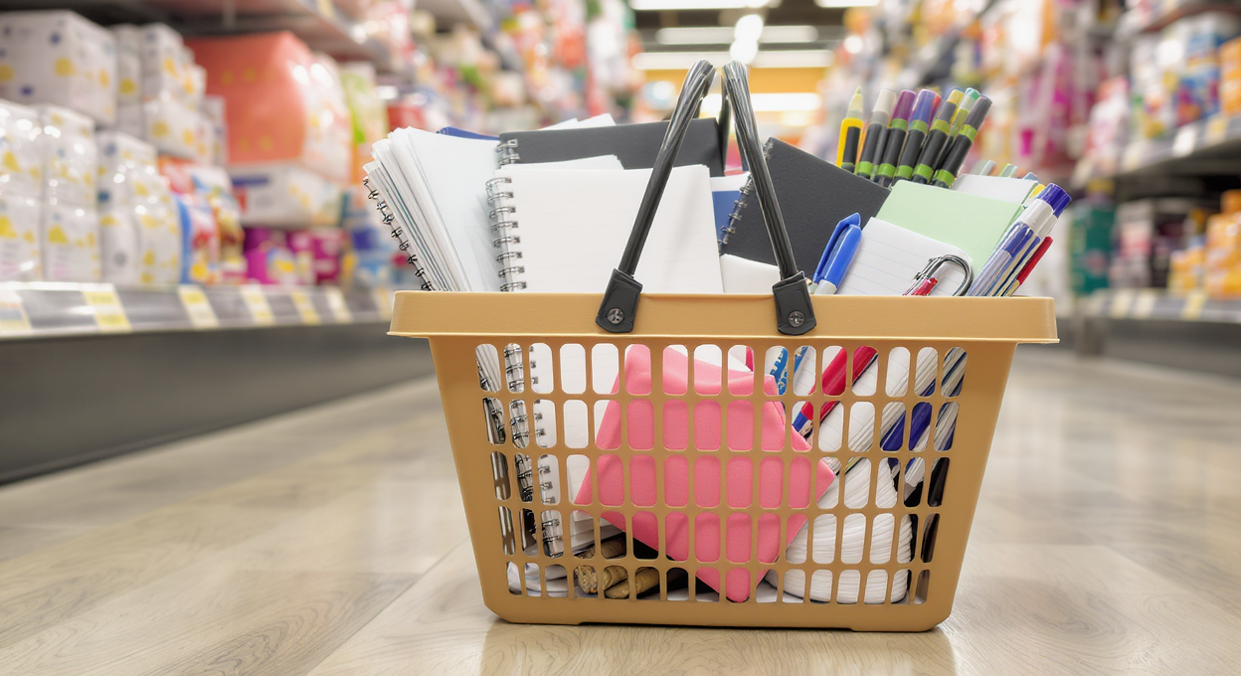
Office Supply Store Trends
Introduction
Key Focus Areas
Key Focus Areas
Analyzing foot traffic and dwell time patterns during the remote work transformation of 2020.
Examining how remote work influenced in-store behaviors and purchasing habits.

Slide 8

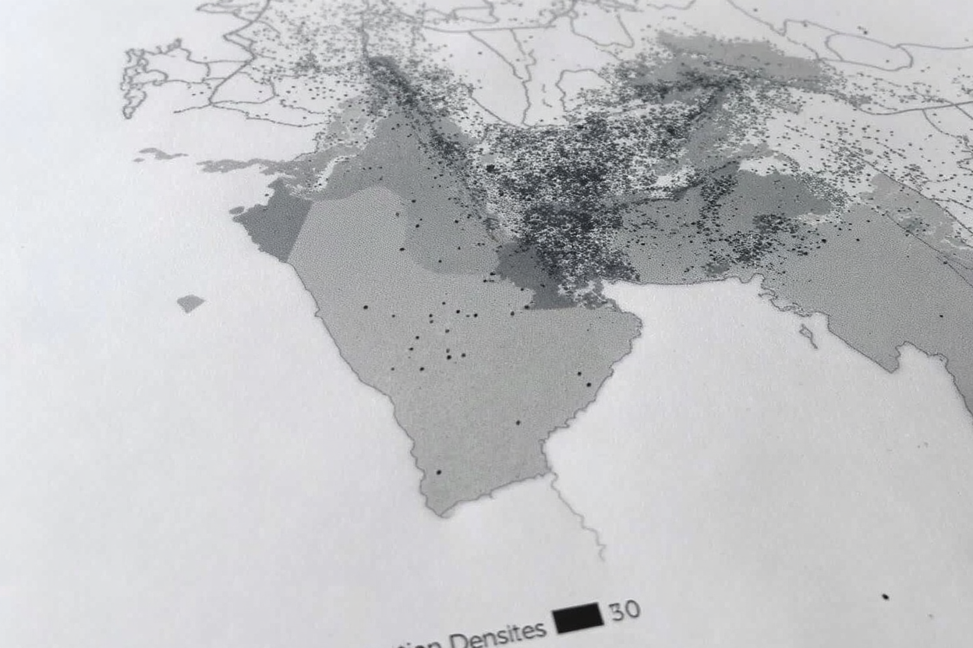
Context and Objectives
Introduction
01
Remote Work Impact
The shift to remote work in early 2020 significantly influenced consumer behavior at office supply stores, changing shopping patterns and needs.
02
Demographic Segmentation
Study segments counties by urban, suburban, and rural areas to analyze store foot traffic and dwell time trends for deeper insights.

Slide 9
Research Question 1 guides the direction of our investigation. Foot Traffic and Demographic Insights at Office Supply Stores (Early 2020)
Analysis
01
02
Trends in Foot Traffic and Shopping Behavior
Demographic Factors and Store Opportunities
Foot traffic peaked early 2020, fell sharply during lockdowns, then rebounded at major office supply stores. Specialty stores had fewer visits but longer dwell times, indicating focused and high-intent customers. Suburban family areas showed increased visits, while urban shoppers preferred quick, goal-oriented trips.
Regions with higher education levels experienced longer store visits, reflecting preference for personalized shopping. Working-age populations (18-64) contributed to weekday traffic fluctuations. K-12 (5-17) households influenced weekend and after-school visit spikes. Demographic data can help identify hot spots for concept stores or expanded community services.

Slide 10
Office Supply Brands: Visits and Market Trends (2020-2023)
Market Analysis
Weekly Visits by Brand (2020-2023)
Brand Wise Market Share %
Average Dwell Time by Brand
Staples and Office Depot consistently lead in weekly visits, with a notable decline in overall visits across all brands from 2020 to 2023.
Staples holds the largest market share among office supply brands, followed by Office Depot and OfficeMax, while smaller brands capture a minimal share.
Average dwell time varies significantly, with some brands attracting customers for longer visits, indicating differences in in-store engagement strategies.

Slide 11
Suburban vs. Urban Office Supply Store Visits During Remote Work Shift
Regional Trends
Suburban and Urban Shopping Patterns
Rural Dynamics and Regional Insights
Suburban counties showed the strongest recovery in foot traffic and dwell time at office supply stores. Staples and Office Depot were key drivers of suburban recovery. Urban centers had slightly fewer visits but maintained similar dwell times. Urban shoppers reflected efficient and purpose-driven shopping habits.
Rural areas experienced fewer visits but longer dwell times. This indicates more deliberate and extended shopping approaches in rural counties. Los Angeles County was a hotspot for office supply demand. Significant regional variations highlight the importance of local dynamics in recovery patterns.

Slide 12
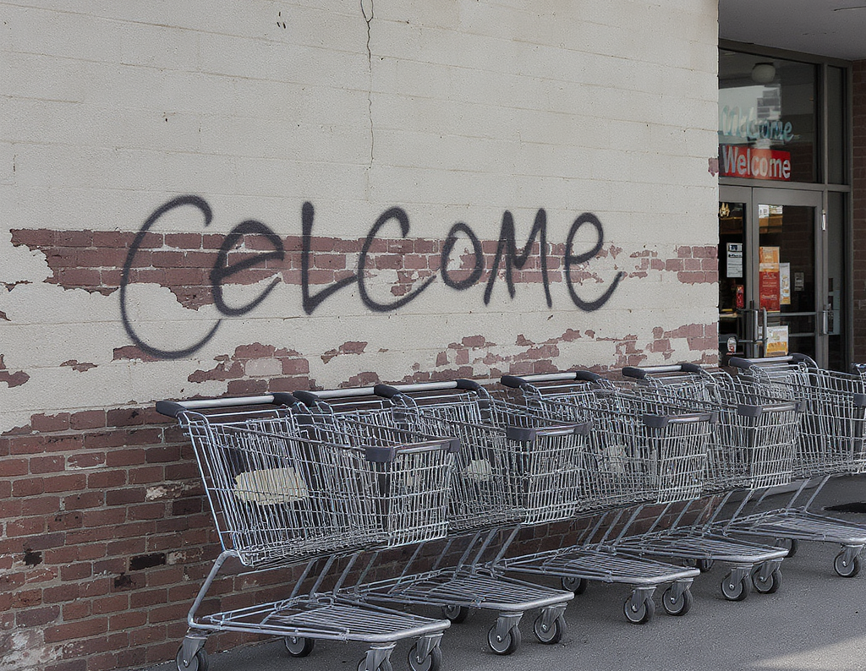
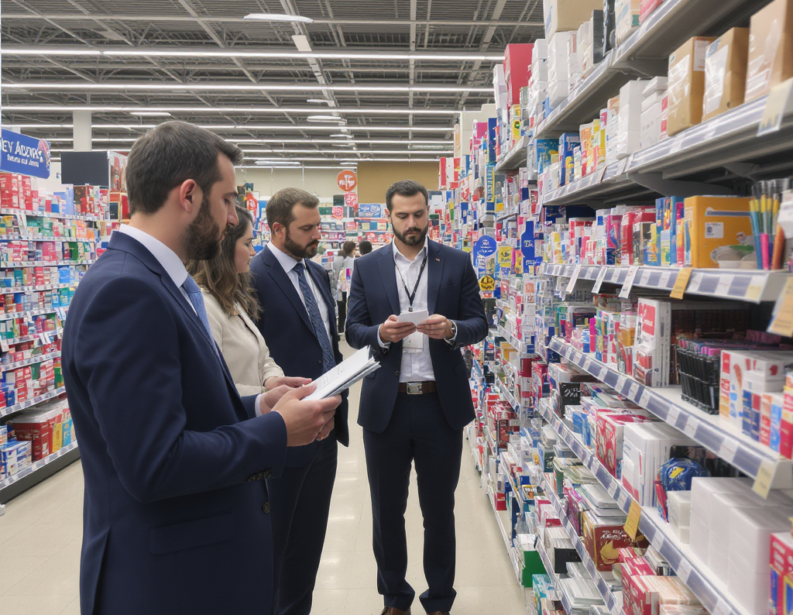
Brand Stabilization and Loyalty in Office Supply Retail
Brand Analysis
Early Brand Stabilization & Divergent Paths
Staples and Office Depot showed early recovery in visits and dwell times, highlighting strong consumer loyalty. By contrast, Office Depot’s steady recovery contrasted with OfficeMax’s lag, reflecting brand overlap and diluted traffic.
Niche Engagement & Essential Status
Specialty brands had low traffic but high dwell times, indicating deep engagement from niche audiences. Essential status and reliable supply chains influenced consumer behavior and brand trust during reopening.

Slide 13
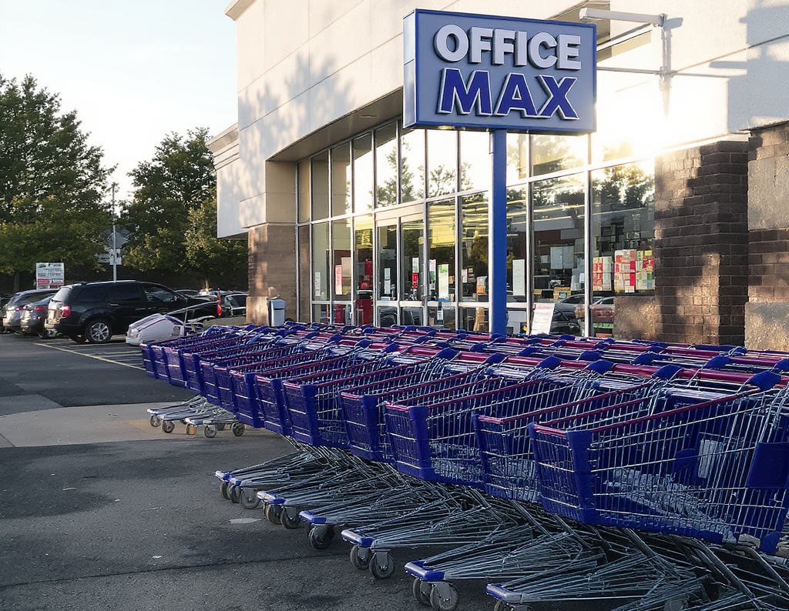
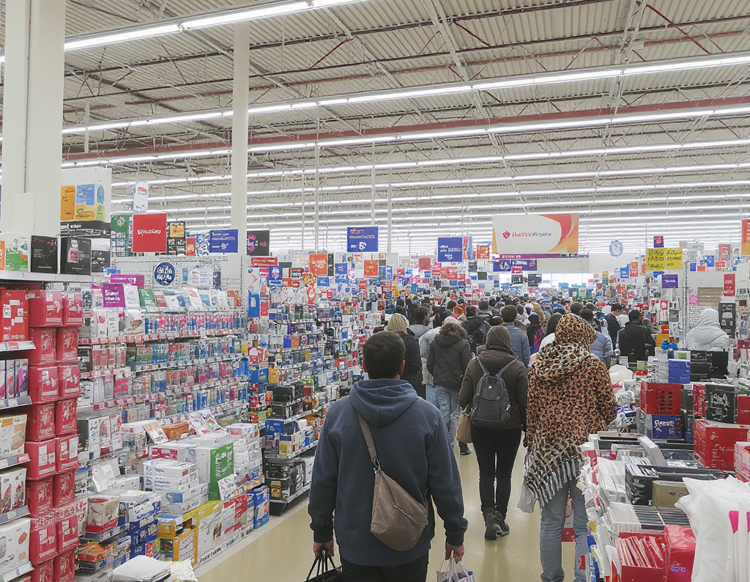
Summary of Insights and Implications
Insights
Suburban Adaptation & Leading Retailers
Suburban consumers quickly adapted to remote work, boosting early recovery in office supply retail sectors. Staples and Office Depot led recovery due to essential status and strong customer loyalty.
Demographic Influence & Retail Strategy
Education, household makeup, and working-age density shaped consumer shopping behavior. Retailers can tailor store formats and products to meet varied consumer needs in a post-pandemic world.

